Slide 1
Quiz Game
Name : MD Fazian
SID :73735
Name :Akas………
SID :75201
Branch : B.Tech (CSE)
Submitted To : Mr. Bharat Bhushan

Slide 2
CONTENT
INTRODUCTION
OBJECTIVE
LIBRARIES&MODULES
FUTURE SCOPE
SCREENSHOTS OF PROJECT
CONCLUSION

Slide 3
INTRODUCTION
A quiz is a form of game or mind sport in which players attempt to answer questions correctly about a certain or variety of subjects. Quizzes can be used as a brief assessment in education and similar fields to measure growth in knowledge, abilities, or skills. They can also be televised for entertainment purposes, often in a game show format.

Slide 4
OBJECTIVE
The Objective behind to organize Quiz competition is to evaluate the knowledge of the participants within academics as well as beyond academics and to make them familiar with the prospects of quizzes and the objectivity of the questions. The main purpose of the competition to develop interest in subject areas of Commerce and Management including competitive aspects.

Slide 5
FEATURES
Educational (General knowledge).
Added comments above code so it will help you understand code much better
It has database to store questions
Correct answer +1 coin (Coins at top left corner)
Timmer of 20 sec for each question (Timer at top right corner)
Random questions at each play (It will peek random ques and will show it to the user)
Good and Extensible UI.
Can be played offline
Compatibility with Android API-14 and above
minSdkVersion 14
targetSdkVersion 25

Slide 6
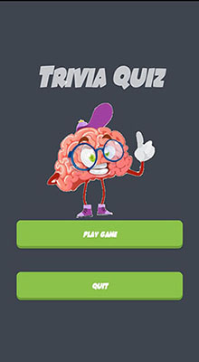
Screenshots

Slide 7
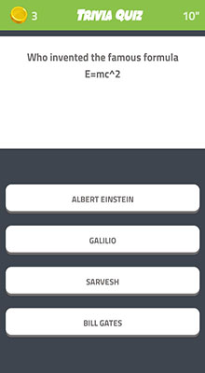
Screenshots

Slide 8
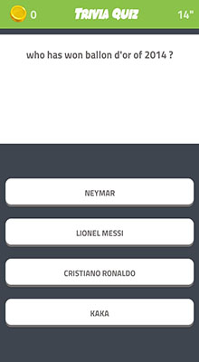
Screenshots
8

Slide 9

Screenshots
Screenshots

Slide 10
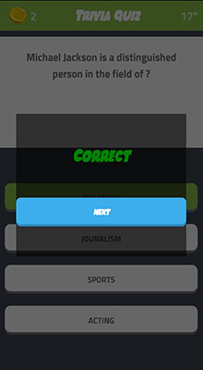
Screenshots

Slide 11

Screenshots

Slide 12
THANK YOU

